Slide 1

phishing attacks
Educate others about recognizing and avoiding phishing emails, websites, and social engineering tactics.

Slide 2

Don't Get Hooked! Phishing Awareness Training
In this training, we'll learn about phishing attacks, a common cybercrime where attackers try to steal your personal information. We'll cover how to recognize phishing attempts and protect yourself from them.

Slide 3
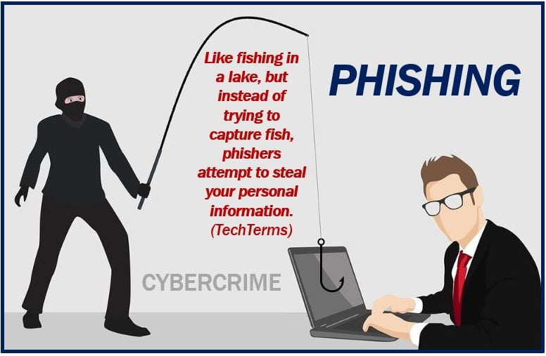
What is Phishing?
Phishing is a deceptive attempt to steal your personal information, such as usernames, passwords, credit card numbers, and Social Security numbers.
Phishing attacks can come in many forms, including emails, text messages, phone calls, and social media messages.
Phishing is a major threat to everyone who uses the internet. Phishers are constantly coming up with new ways to trick people, so it's important to be aware of the latest tactics.

Slide 4
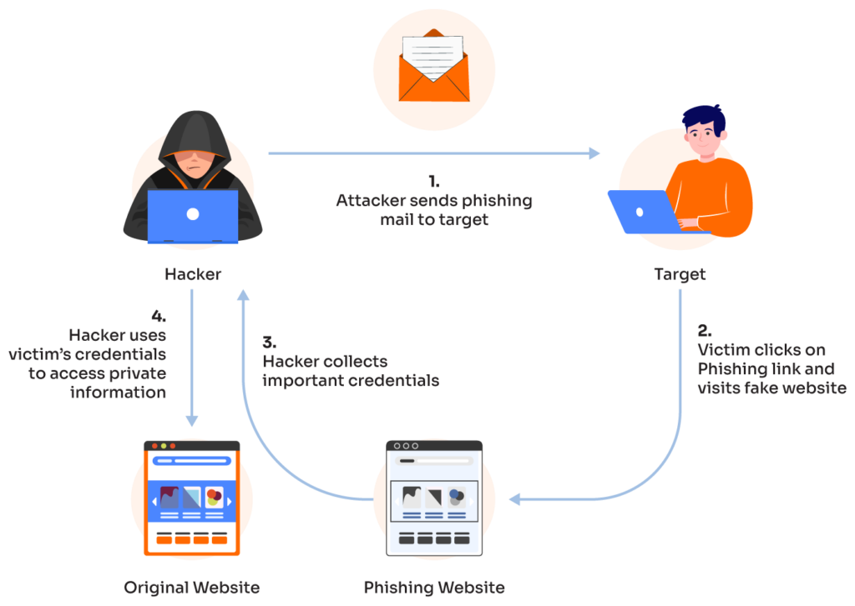
How Phishing Works
Phishers typically send emails or messages that appear to be from a legitimate source, such as a bank, credit card company, social media platform, or even a friend.
The message will often create a sense of urgency or importance, trying to pressure you into clicking on a link or opening an attachment.
The link or attachment will take you to a fake website that looks like the real website. Once you enter your information on the fake website, the phisher can steal it.
Phishers are very good at making their emails and messages look real. They may use logos, fonts, and other design elements that are copied from the real company. They may also use personal information that they have obtained about you from other sources, such as social media.

Slide 5
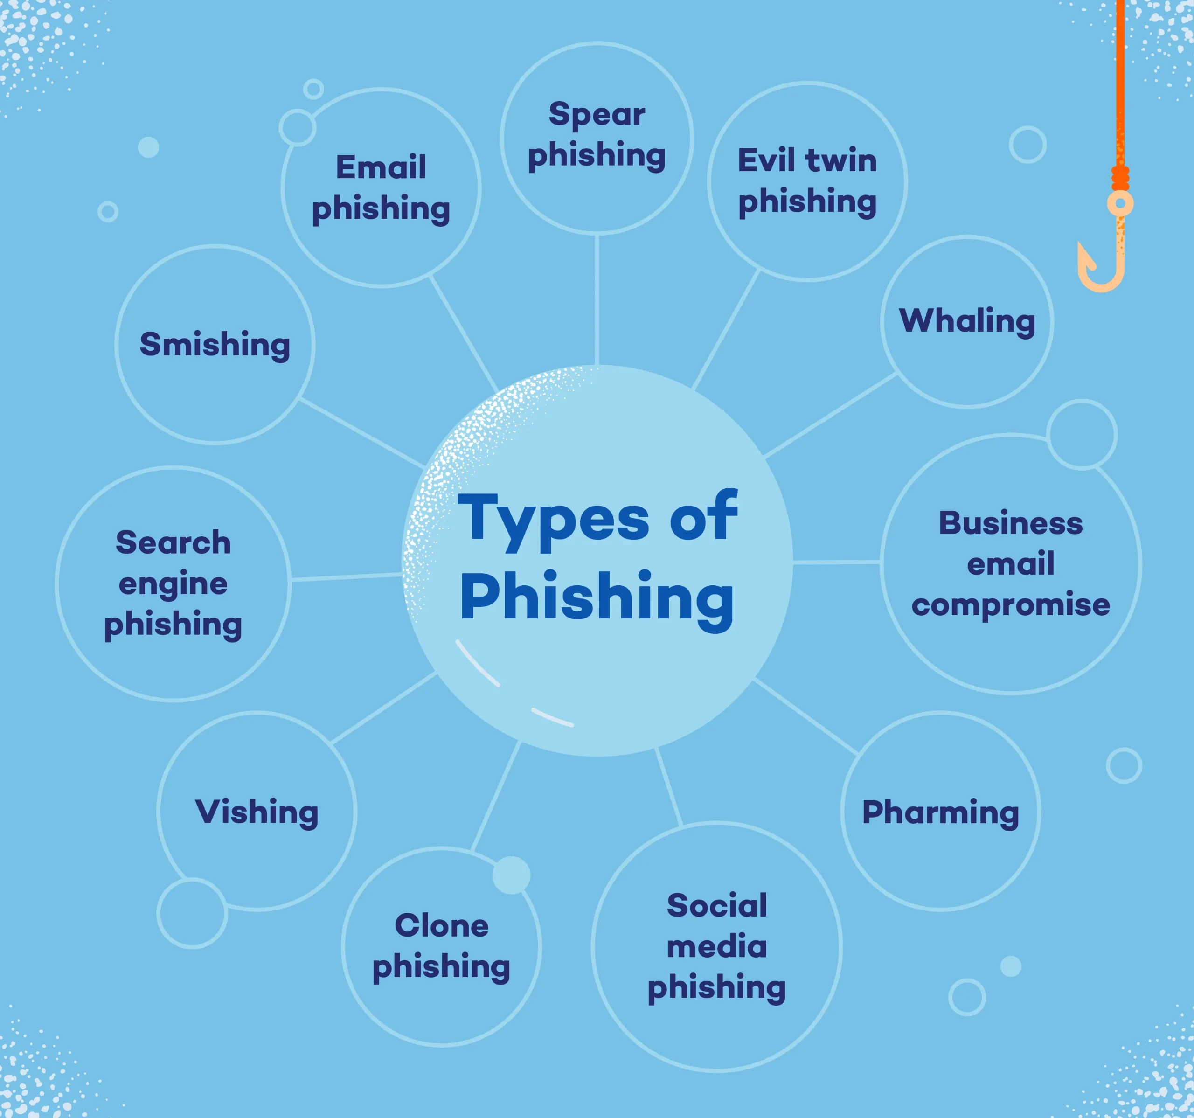
Common Types of Phishing Attacks
Email Phishing
Email phishing has been around since the 1990s. Typically, the email alerts the victim to the compromise of an account and requests that they respond immediately by clicking on a link. Most of the time, these emails are easy to spot because they have spelling or grammar mistakes.
Spear Phishing
Spear phishing attacks target a particular group or type of person, such as a system administrator or HR director. These emails may talk about the recipient's area of expertise, include a link to a file download that the victim is told to click, and demand a quick answer.
Whaling
Whaling is a type of phishing that is even more specific and tries to trick a "whale," like a CEO or CFO in a certain industry or company. The email may threaten the company with legal action, or mention "inside" financial information. Of course, the intended victim must click a link to "learn more" and is then directed to a fake website where they must enter login credentials and important company information, such as tax IDs and bank account numbers.

Slide 6
Common Types of Phishing Attacks
Smishing
Smishing is an attack that is carried out through cell phone text messaging or short message service (SMS). Smishing attacks often look like they come from a bank and come in the form of SMS messages. The text message informs the recipient that their account has been compromised and that they must act right away. The attacker questions the victim about their bank account number, SSN, etc. The attacker then has access to the victim's bank account.
Vishing
A vishing is carried out via phone call. A typical vishing attack involves a call from a person posing as a representative from a computer hardware, software, or antivirus company. They tell the victim that they have found a virus on the victim's computer. The attacker will then ask for credit card numbers so that the antivirus program on the computer can be updated. If successful, this type of attack is a double whammy: the attacker gets valid credit card information and may also have installed malware on the victim's computer. The malware might include anything from a bot to a Trojan that spies on the victim's online behavior in order to steal more information, such as bank account credentials.
Man-in-the-Middle
The latest evolution of phishing attacks is the Man-in-the-Middle (MITM) toolkit, which acts as malicious reverse proxy servers of online services, mirroring target website content to users while extracting credentials like MFA tokens and session cookies in transit.

Slide 7
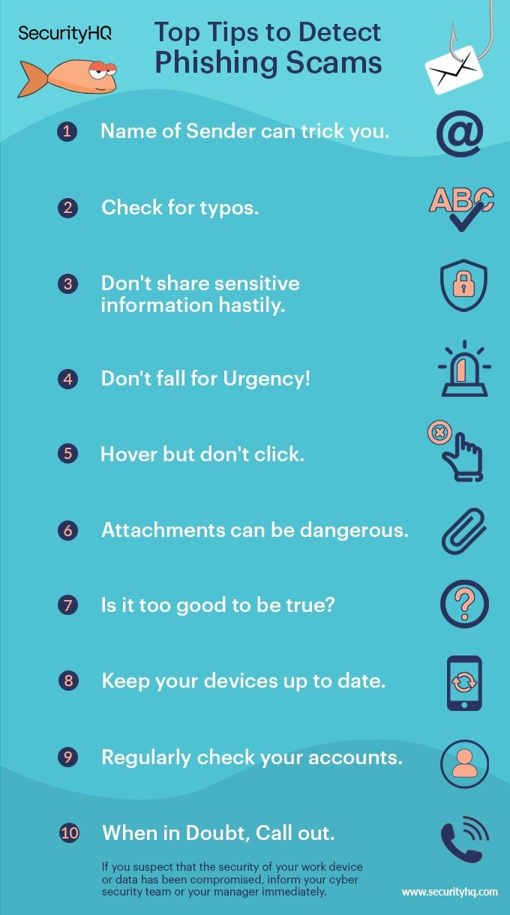
How to Recognize Phishing
Be suspicious of any emails or messages that ask you to click on a link or open an attachment.
Don't click on links or open attachments from senders you don't know.
Check the sender's address carefully. Phishing emails often have typos or misspellings in the sender's address.
Be wary of emails or messages that create a sense of urgency or importance.
If you're not sure whether an email or message is legitimate, contact the sender directly to verify.
There are a few key things to look for when trying to identify a phishing attempt. By following these tips, you can help protect yourself from falling victim to a phishing attack.

Slide 8
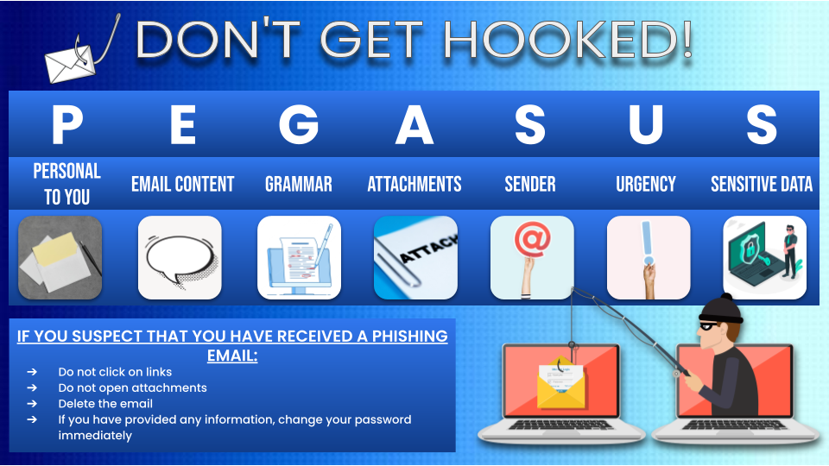
What to Do If You Receive a Phishing Email
Do not click on any links or open any attachments in the email.
Delete the email immediately.
If you think you may have entered your personal information on a fake website, report the phishing attempt to the legitimate company and change your passwords immediately.
If you think you've received a phishing email, the best thing to do is to delete it immediately. Don't click on any links or open any attachments. If you're concerned that you may have entered your personal information on a fake website, contact the legitimate company and report the phishing attempt. You should also change your passwords immediately.

Slide 9
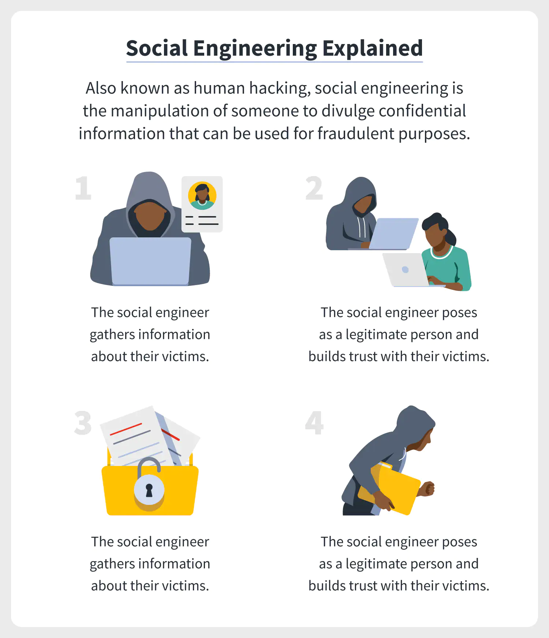
Social Engineering
Social engineering is a tactic that phishers use to trick people into giving up their personal information.
Social engineers may use a variety of techniques, such as:
Pretending to be a friend or family member
Posing as a customer service representative
Creating a sense of urgency or importance
Offering a reward or incentive
. Social engineering is a common tactic used

Slide 10
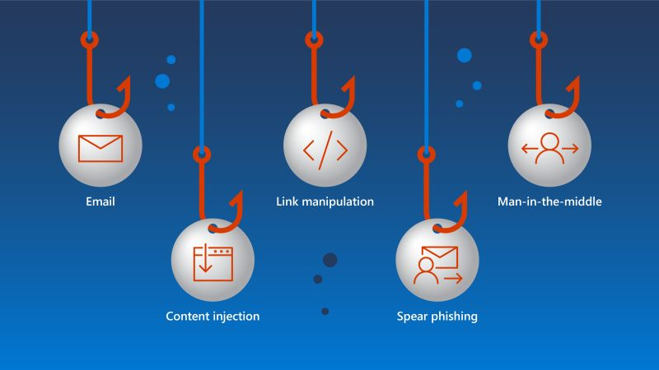
Link manipulation
Link manipulation involves sending an email or text message containing a malicious link that leads to a phishing website that appears legitimate but is actually designed to steal personal information from unsuspecting victims. Hackers often use shortened URLs to send people to malicious websites, and they may use domain spoofing to make their messages look like they came from a real company.

Slide 11
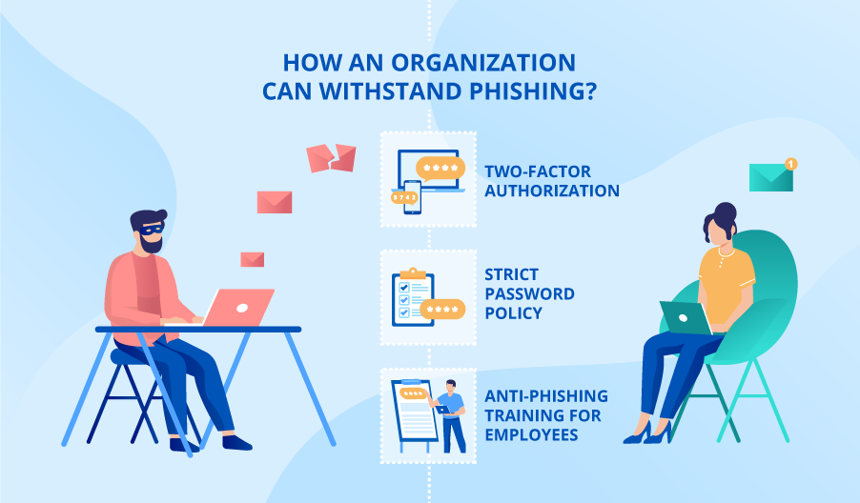
Preventing Phishing Attacks
Educating Yourself and Your Employees
The first step in preventing phishing attacks is educating yourself and your employees on the dangers of phishing attacks and how to recognize them. Be aware of suspicious emails, website links, and attachments that could be malicious. It's also important to have strong password policies in place and use multi-factor authentication whenever possible.
Multi-factor Authentication
MFA) asks users to prove who they are with two or more pieces of information, like a password, email address, phone number, or biometric data. This additional layer of security makes it more difficult for hackers to gain access to your accounts. In theory, MFA also ensures that even if a user's credentials are stolen during a phishing scam, the hacker won't be able to access the account without additional verification. But, in practice, scammers can now use Man-in-the-Middle attacks to circumvent MFA.
Security Solutions and Tools
Another critical step is regular backup of data, so that if you do become the victim of a phishing attack, you can recover quickly. To protect against phishing attacks, organizations should also use security tools like a firewall and anti-spam filters. Most importantly, businesses need a holistic cybersecurity plan that includes a robust bot management solution—like Arkose Labs—that can detect phishing attacks and stop them before damage is done.
The Arkose Labs’ platform combines transparent detection with targeted attack response to catch fraud early in the customer journey without impacting good users. It is set up before the MFA step in a website's login and registration workflows. The login or registration workflow can be completed provided the web server receives the token issued by the Arkose Platform upon successful completion of the detection and adaptive challenge response processes.

Slide 12
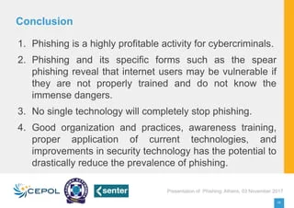
Conclusion
Phishing attacks are a growing threat, and it's important to understand how they work and the impact they can have. Attackers can get people to give them sensitive information or download malware by using techniques like social engineering, link manipulation, and filter evasion. Common types of phishing attacks include SMS phishing, voice phishing, spear phishing, whaling, social media phishing, and more. If you fall for a phishing attack, you could lose your data, have your identity stolen, or lose money. Preventing these attacks requires education and security solutions. Take action now to protect yourself and your business from these dangerous threats.

Slide 13

THANK YOU

